Slide 1
DYNAMIC ASSESSMENT SYSTEM USING KNOWLEDGE AND DATA ENGINEERING
PROPOSED BY : S.CHITRA (20610104305)
S.MONICA (20610104312)
BATCH NO : 15
REVIEW NO : 2nd Review
PROJECT GUIDE : MR. JUSTIN DHAS Y, M.E, Asst.Proff.

Slide 2


CONTENT
1.SCOPE
2.OBJECTIVE
3.EXISTING SYSTEM
4.PROPOSED SYSTEM
5. ARCHITECTURE
6.DATA FLOW DIAGRAM
7.ALGORITHM
8.MODULES
9.OUTPUT SCREENSHOTS

Slide 3
SCOPE
Dynamic assessment pattern creation
Voice bio-metric authentication
Audio questions and speech synthesis answers
Mock assessment
Topic based e-materials download
Saves time on assessment conducting

Slide 4
OBJECTIVES
The system should be Generic System. So that it should be suitable for all environments like educational institutes, Mock practice system or conducting quiz events, etc.
Goal of system is to allow assessment admin to create assessment pattern and upload question to schedule the assessment with secure access on question base.
Student those who attend the questions can get the immediate result by auto grading.
System enables to create patterns with conditions:
  Negative Marks
  Section wise Minimum cut-off
  Timer on each question
  Compulsory questions

Slide 5
EXISTING SYSTEM
Existing system provides security on client level authentication
Not focused on question base theft from the server
Time consuming
No audio question for disabled candidate.

Slide 6
DISADVANTAGES
No auto grading and candidate based assessment progress.
Only customized assessment system, So requires to develope
assessment system for different pattern.
System performance is very low.

Slide 7
PROPOSED SYSTEM
Server side heavy security on access of question base to avoid question theft.
Enables audio questions on web and speech synthesized answer for disabled people.
Mainly focused on auto grading and stores result on candidates review progress.
Dynamic creation of assessment pattern gives generic system and avoid development of assessment system again for different pattern.
Better performance compared to existing system.
Time effective on designing pattern and conducting assessments.
Graphical report generation

Slide 8
ADVANTAGES
User friendly question-base upload
Accurate auto-grading
Graphical report generation
Candidates based assessment review

Slide 9
ARCHITECTURE DIAGRAM
Data bank
Pattern creation
Pattern data
Examination Engine
Question Base Creation
User data
Question data
Pattern Selection
Auto Grading System
Answer data
Report Generation
E-Materials

Slide 10

DATAFLOW DIAGRAM LEVEL 0
Student
Exam registration
Registration
Assessment System
Already registered
Admin
Login
encrypt

Slide 11
DATAFLOW DIAGRAM LEVEL 1
Select Pattern
Admin
Pattern
Encrypt
Create Pattern
Provide Pattern
Login
Select
Question Base
Question Base
Questions
Categories
Upload Questions
Provide Materials
User Management
Manage
Student Details
View Student Details
E-Materials

Slide 12
DATAFLOW DIAGRAM LEVEL 2
Report
(Auto-Grading)
Student
Assessment System
Encrypt
Feed back
Login
E-Materials
Log out
Change Password
View
Download

Slide 13
ALGORITHM
RSA ALGORITHM:
Step1:Generate Public Key
Select two prime P & Q
eg. P=53 Q=59
Start to calculate first part of the Public key=n
PQ=n or 53*59=3127
We also need a small exponent e
Be an integer
Not be a factor of n
1<e<φ(n)
Eg: e=3
Our public key made up of n and e(i.e) 3127 and 3

Slide 14
Cont.
Step 2:Generate private key
  We need to calculate φ(n)
φ(n)=(P-1)(Q-1)
φ(n)=(53-1)(59-1)
φ(n)=3016
  Now calculate Private Key=d
d=2(φ(n))+1/e
2011=2(3016)+1/3
Step 3:Encrypt data with Public Key
    Our public key is made up of n & e
    Our private key is made up of d

Slide 15
Cont
Eg:
lets encrypt “HI”
Convert letters to number : H=8 & I=9
“89”
C=Encrypted Data
C=89^e mod n
1394=89^3 mod 3127
Step 4:Decrypt Data with Private Key
c=Encrypted Data
d=Private Key
n=Public Key

Slide 16
Cont.
Decrypted Data=c^d mod n
89=1394^2011 mod 3127
So Here,
8=H 9=I
“HI”

Slide 17
MODULES
Authentication Module
Pattern Creation Module
Examination Engine Module
User Management Module
Report Module

Slide 18
AUTHENTICATION MODULE
Register
Validate & Encrypt
Store on DB
Send Password Email
Login
Authenticate & Authorize User
Show authorized page
Logout

Slide 19
AUTHENTICATION MODULES
Candidate registers system with required details
After validating candidate information, store on DB with encryption of password like sense informations
Send randomized generated password via Email to the candidate
User authenticated and authorized when tries to login and display the authorized page

Slide 20
PATTERN CREATION MODULE
Set number of Sections
Question Base Creation
Map Question Base for each sections
Set Conditions
Schedule Assessment

Slide 21
PATTERN CREATION MODULE
Set number of sections
Upload questions to the question base
Select question base for each sections
Set conditions like
  Negative Marks
  Section wise Minimum cut-off
  Timer on each question
  Compulsory questions
Schedule assessment

Slide 22
EXAMINATION ENGINE MODULE
Authenticate Candidate
Mock Exam
Select Assessment
Attend Original Assessment
View Instant result with Answers using auto grading
FEEDBACK

Slide 23
EXAMINATION ENGINE MODULE
Authenticate candidate to select exam
Attend exam based on selected assessment
View the result and answer for the assessment using auto-grading
Give feedback for assessment

Slide 24
USER MANAGEMENT MODULE
Auto Grading and stores Result
Edit Profile Information
View Progress Review
User Dashboard
Submit Feedback

Slide 25
USER MANAGEMENT MODULE
Enter User Dashboard after authentication.
Attend Exam and get the auto Grade
View Progress Review
Edit profile information
Submit Feedback

Slide 26
REPORT MODULE
On Complete of Scheduled Exam
Generate Instant Result to candidate with answers
Generate Shortlisted candidate list
Display Progress review information

Slide 27
REPORT MODULE
Complete the scheduled exam
Generate instant result using auto grading with answers
Generate shortlist candidate
Display candidate progress history

Slide 28
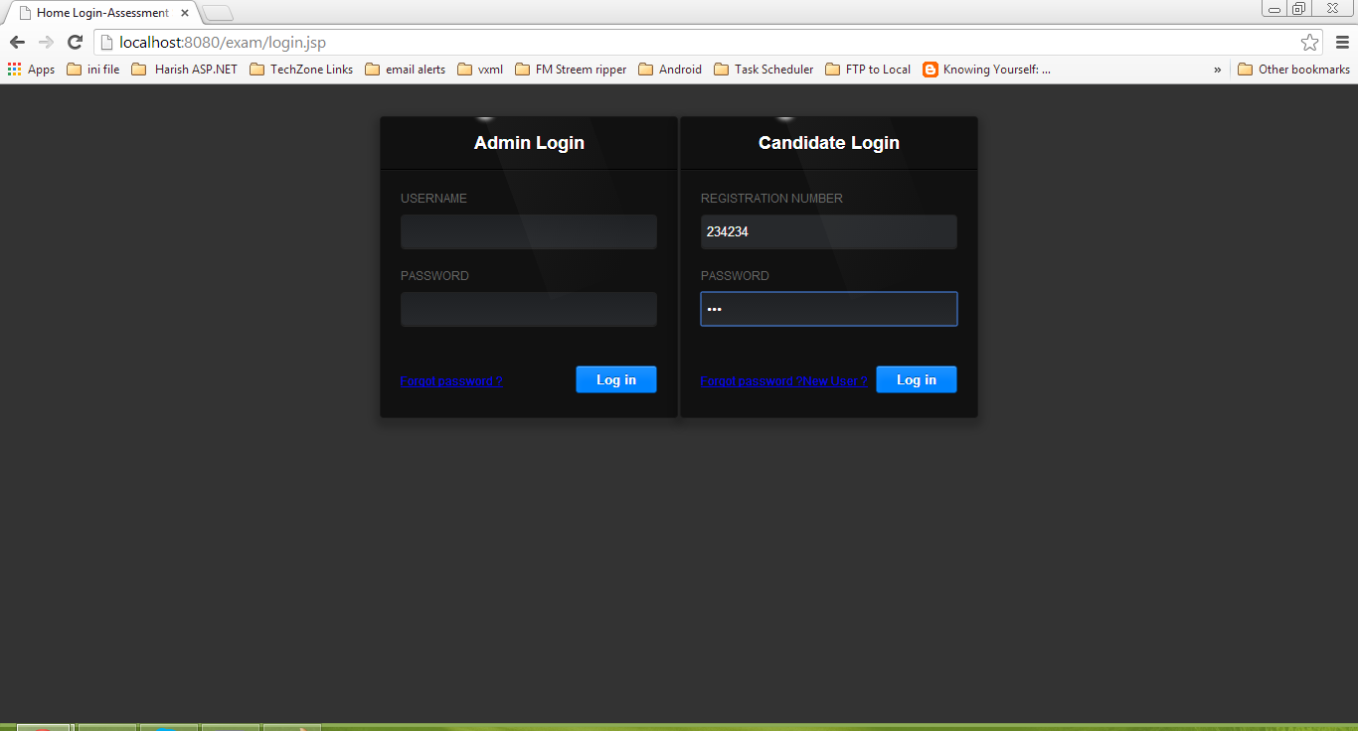
SCREENSHOTS

Slide 29

CONT.

Slide 30
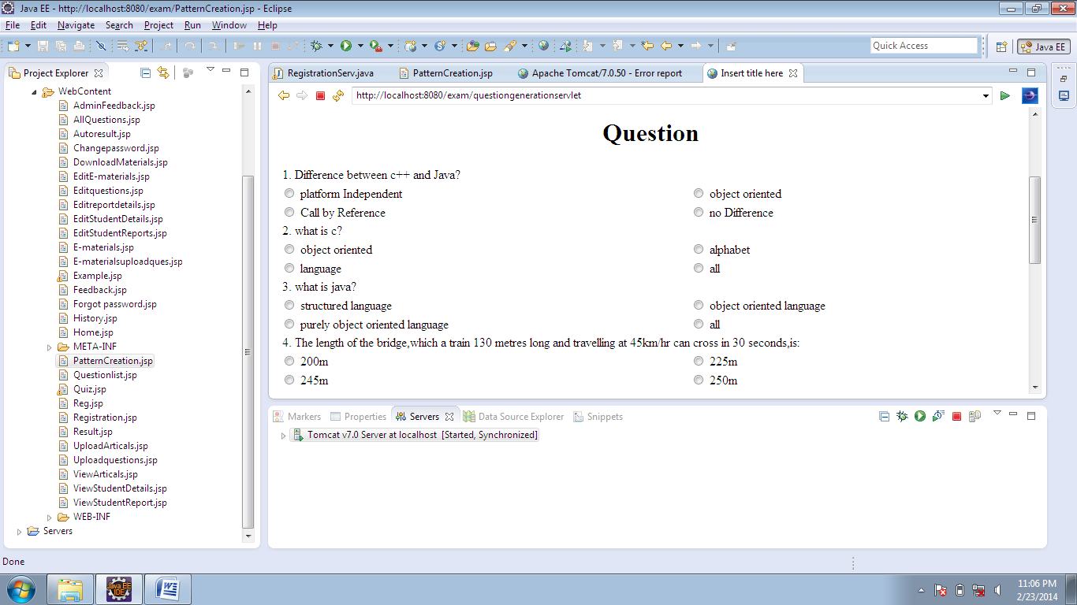
CONT.

Slide 31
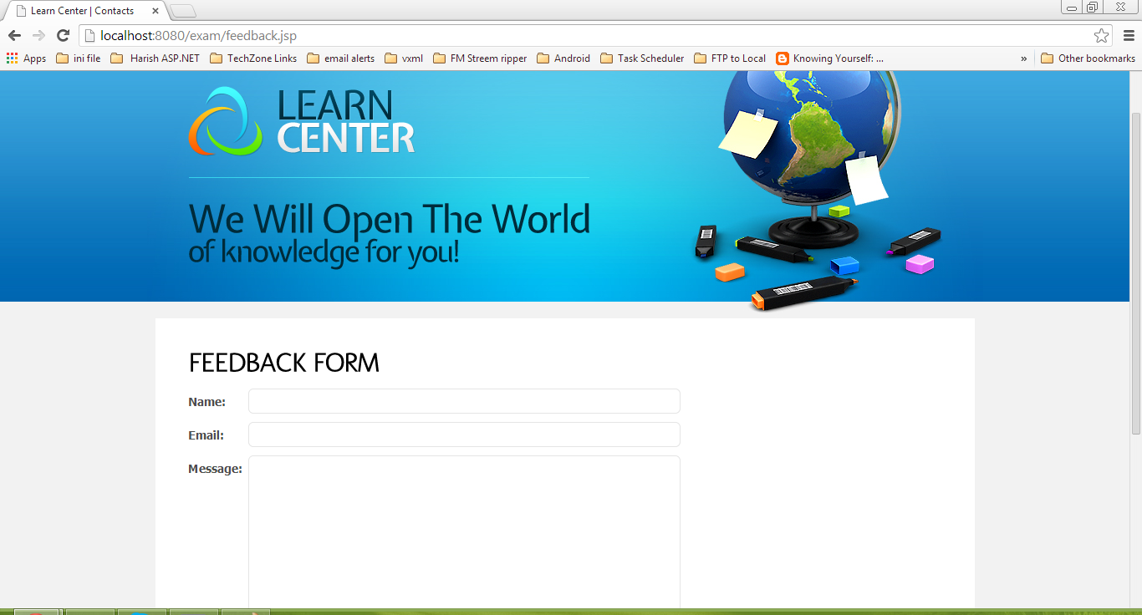
CONT.

Slide 32
REFERENCES
I. Hernán-Losada , C. Pareja-Flores, and J. Velázquez-Iturbide“Testing-Based Automatic Grading: A Proposal from Bloom’sTaxonomy “, Eighth IEEE International Conference on Advanced Learning Technologies, 2008.
W. Huang, X. He, and Lin Qiao, “The Design and Implementation of Web-based E-learning Examination System Based on J2EE “, Proceedings of the International Conference on Information Technology,2004 IEEE.
Yuan Zhenming1, Zhang Liang2, Zhan Guohua3 , " A novel Web-Based online examination system for computer science education “, 33rd ASEE/IEEE Frontiers in Education Conference , 2003.
S. Bonham, A. Titus, R. Beichner and L. Martin, “ Educationresearch using web-based assessment systems “, Journal of Research on Computing in Education, Fall 2009.

Slide 33
THANK YOU!!

